Slide 1


Structured population modelling
Dr Kamil Erguler
Research Scientist
Climate and Atmosphere Research Center (CARE-C) The Cyprus Institute
k.erguler@cyi.ac.cy

Slide 2




A model for life under variable conditions Multi-process dynamic pseudo-stage-structured (sPop)
Population structure is dynamic and adaptable to a variable environment
dynamic
structuring
multi-process
Several processes can be combined to act upon a life stage
Progress accumulates through ageing or pseudo-stages
pseudo
stages
SPECIAL THANKS
Jacob Mendel Sean L. Wu
github.com/kerguler/Population
github.com/kerguler/Population.jl
Erguler, K. et al. Sci Rep (2022)

Slide 3
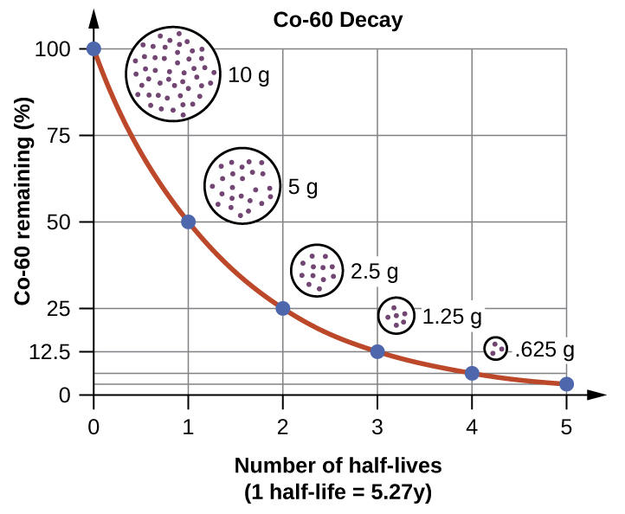
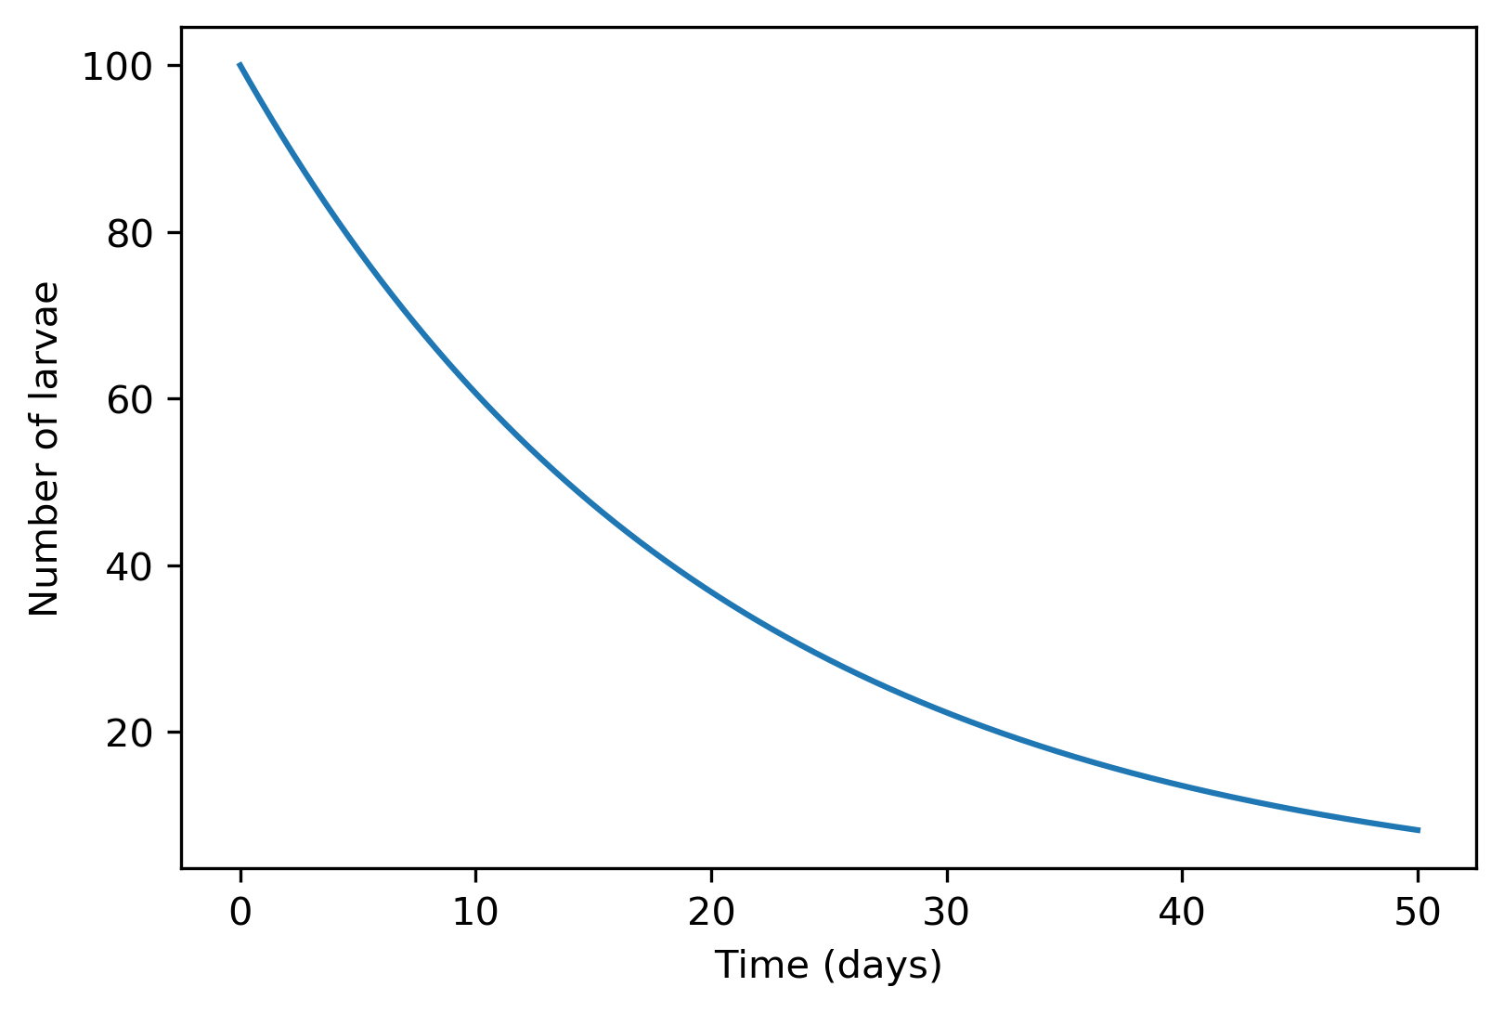
Population dynamics modelling
Canonical
ODE models

Slide 4
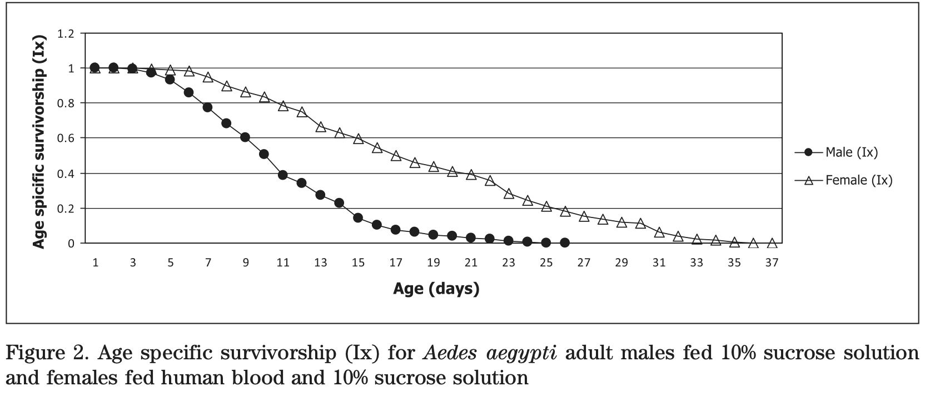
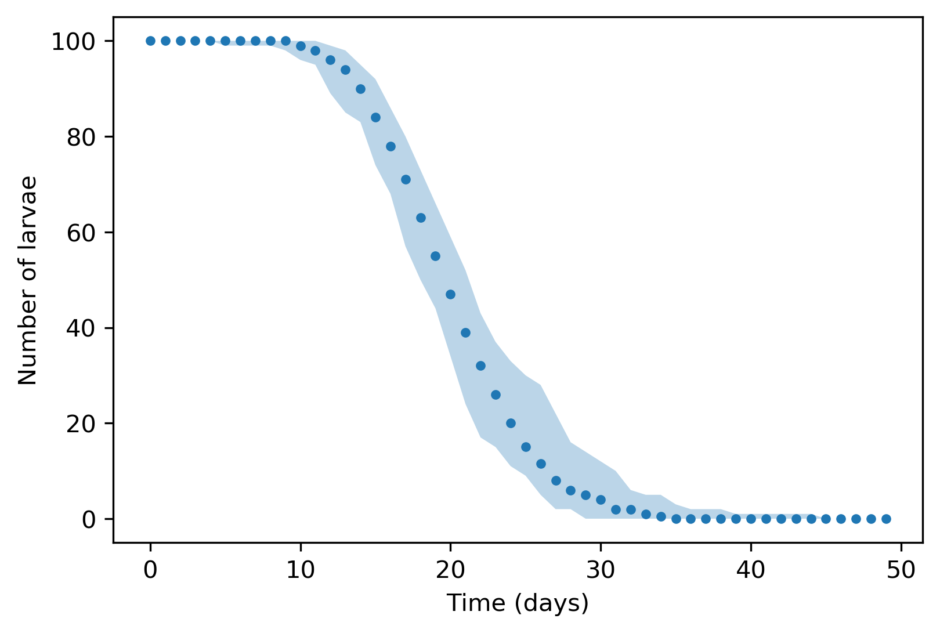
Population dynamics modelling
Canonical
ODE models
Structured
population
models

Slide 5
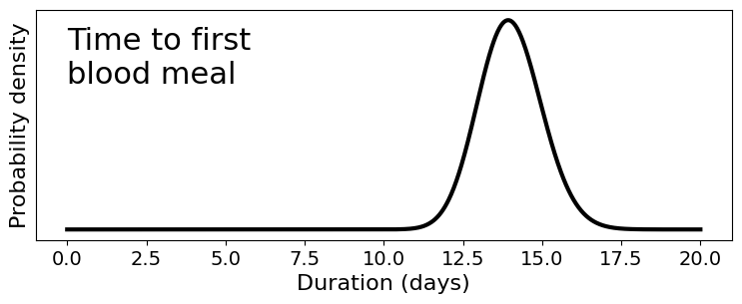
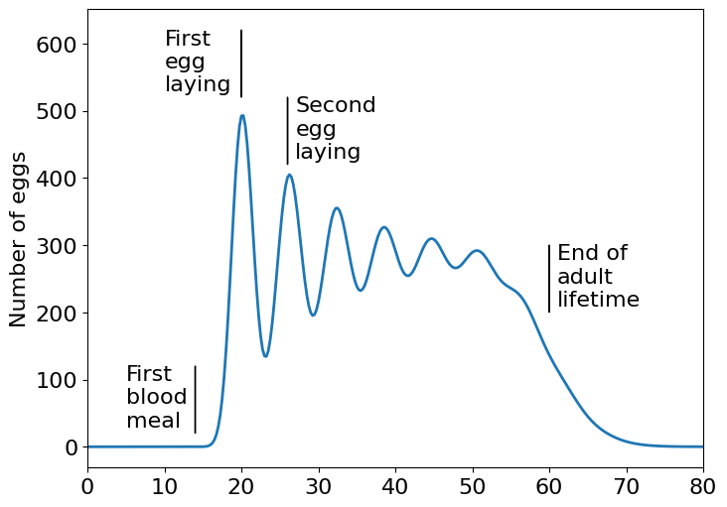
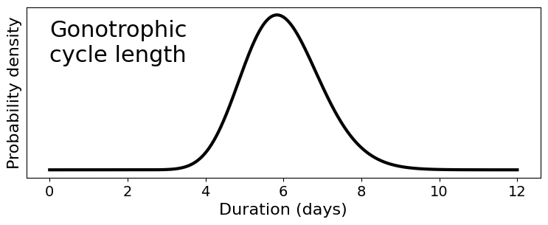

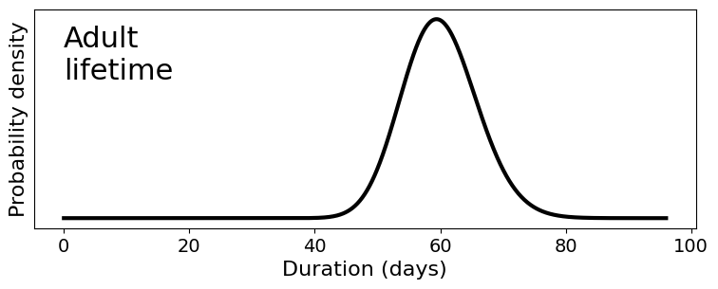
Dynamic multi-process modelling

Slide 6

How does it work?

Slide 7
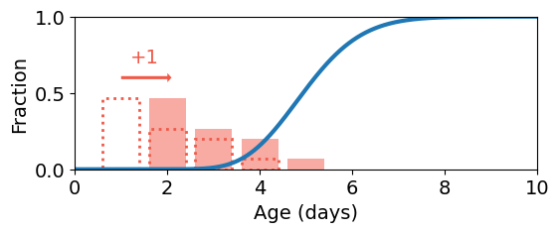
Age-structured population dynamics
Age-structured population dynamics
4
6
5
7
4
7
+1
5
8
5
5
6
6
4
6
5
7
4
4
5
6
5
5
4
5
6
5
6
7
4
5
Day 1
Day 2
Population structure is maintained
All individuals age one day
Stage duration probability distribution determines the fraction passing to the next stage

Slide 8
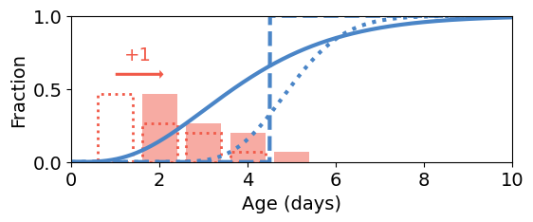
Age-structured population dynamics
Age-structured population dynamics
4
6
5
7
4
7
+1
5
8
5
5
6
6
4
6
5
7
4
4
5
6
5
5
4
5
6
5
6
7
4
5
Day 1
Day 2
Change in conditions
Change in stage duration probability

Slide 9
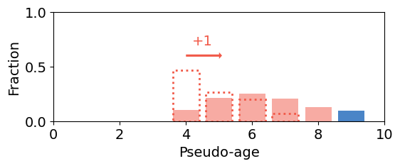
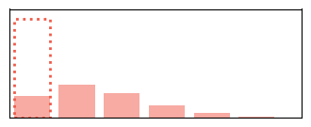
Accumulative population dynamics
Age-structured population dynamics
9
4
6
5
8
4
7
5
5
5
6
7
4
6
6
7
4
4
4
6
6
5
4
5
6
4
7
8
4
5
Day 1
Day 2
Population structure changes every day
Individual rate of progress is variable
Rate may change with the conditions
Stage duration is determined by an intangible maximum pseudo-age

Slide 10
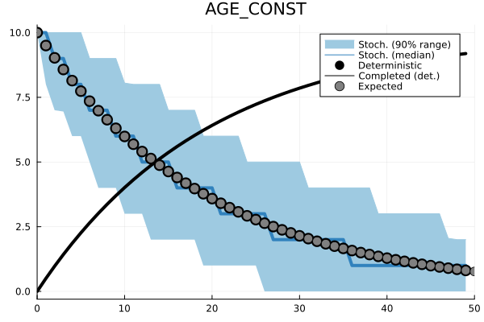
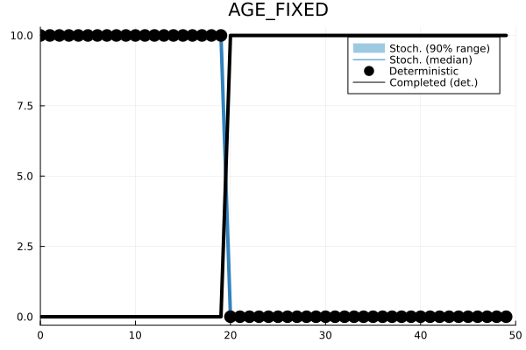
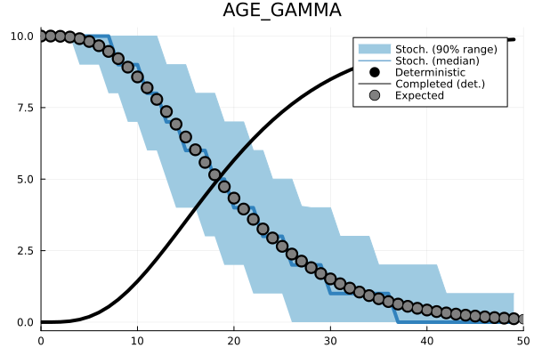
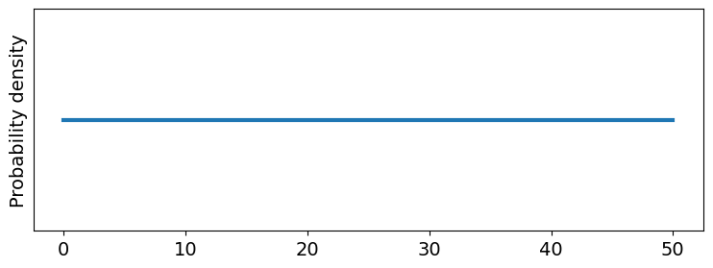
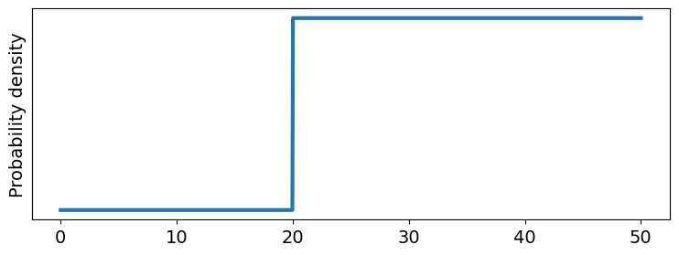
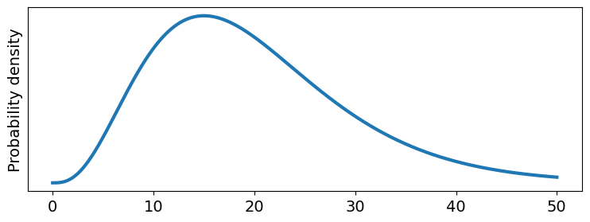
When does development complete?
Structured population dynamics model
At a constant rate
When all individuals
reach a certain state
Most likely when an individual
reaches a certain state

Slide 11
PopJSON

Slide 12
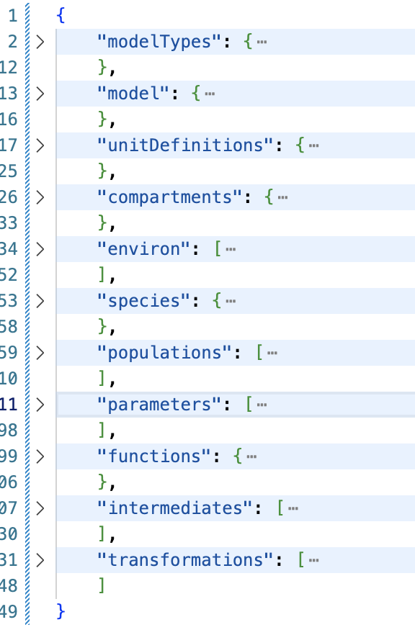
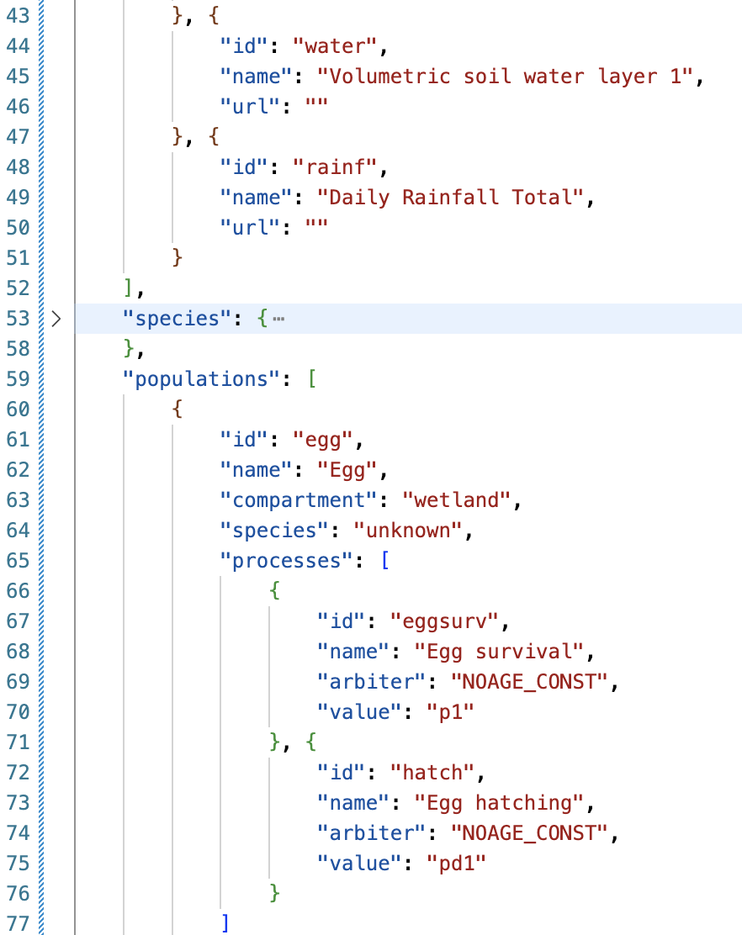
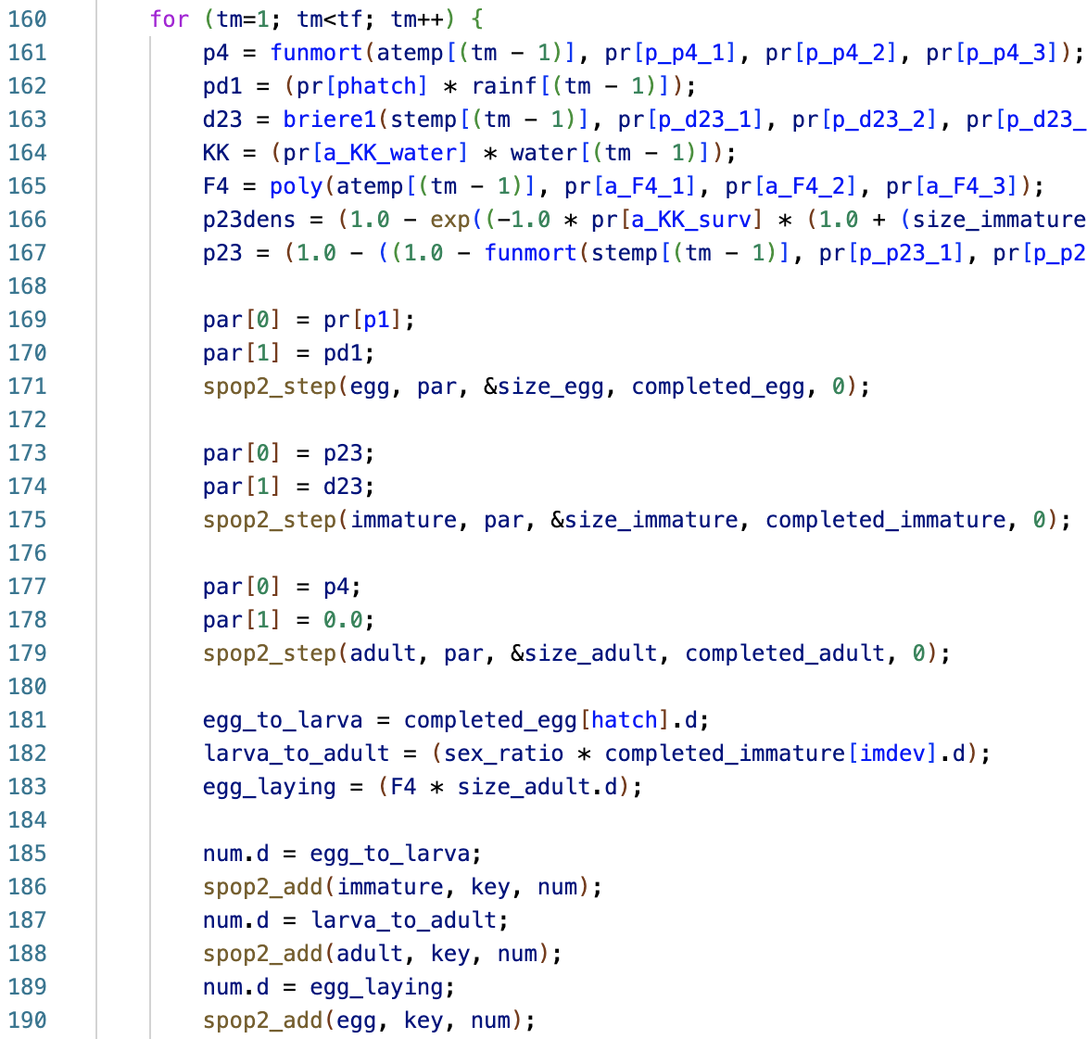
Population dynamics model representation
PopJSON
C
github.com/kerguler/PopJSON

Slide 13
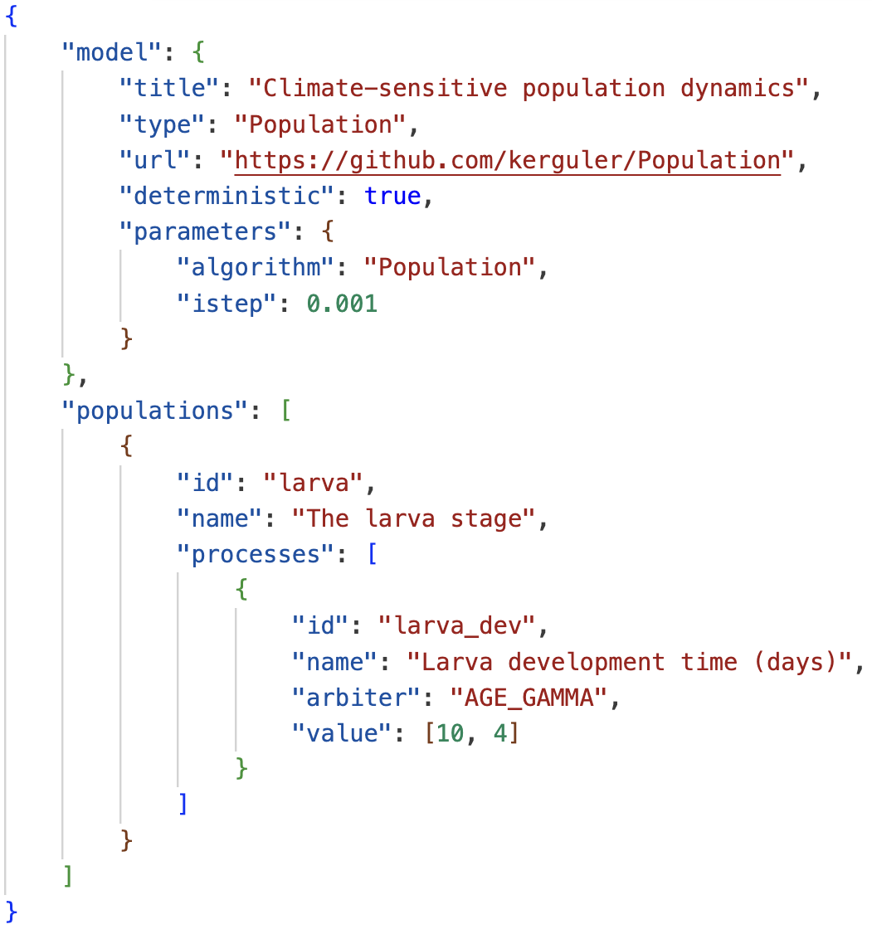
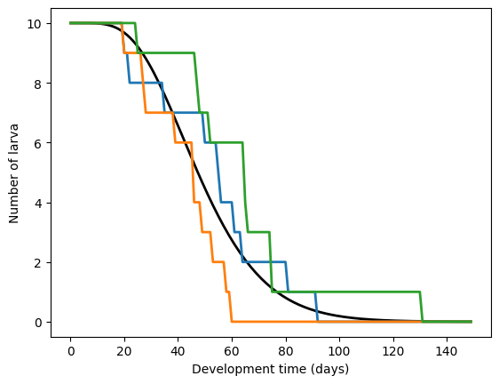
PopJSON

Slide 14
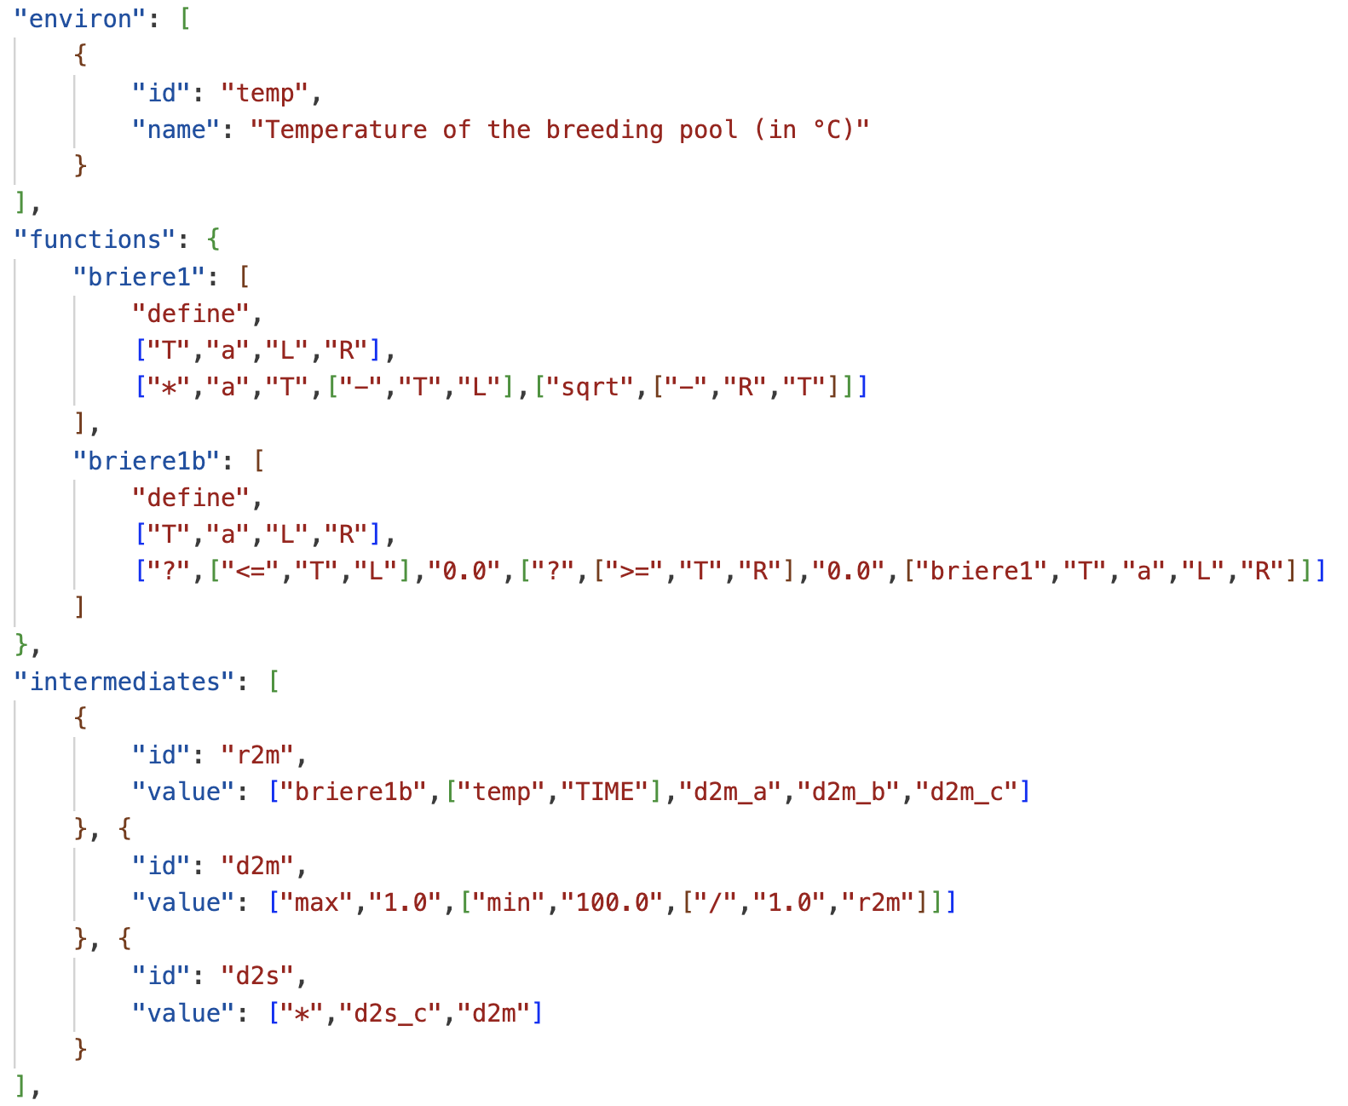
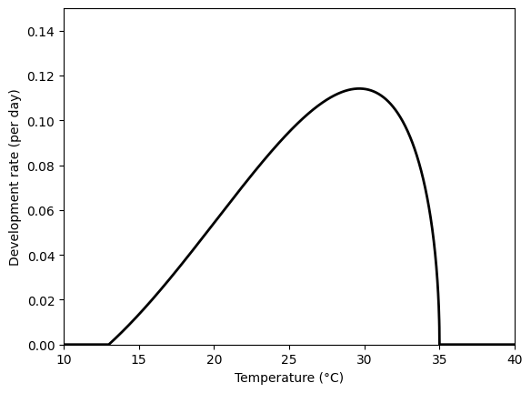
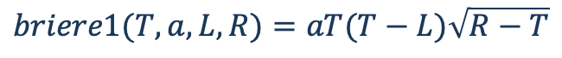
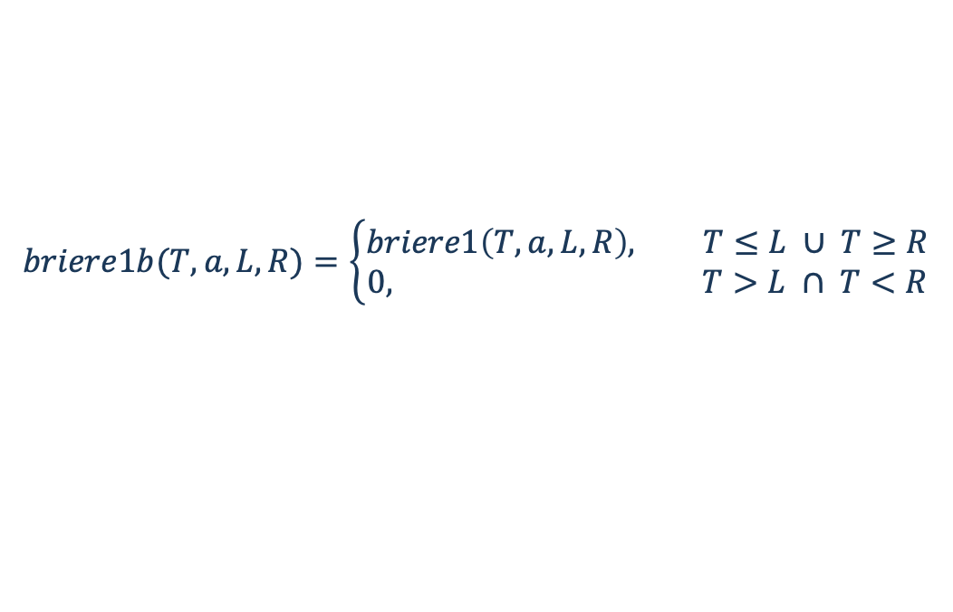
PopJSON
$$briere1(T,a,L,R)=aT(T−L)\sqrt{R−T}$$
Condition
If true
If false
Condition
If true
If false
$$briere1b(T,a,L,R)=\left\{\begin{aligned}briere1\left(T,a,L,R\right), T≤L ∪ T≥R \\ &0, T>L ∩ T<R\end{aligned}\right.$$

Slide 15
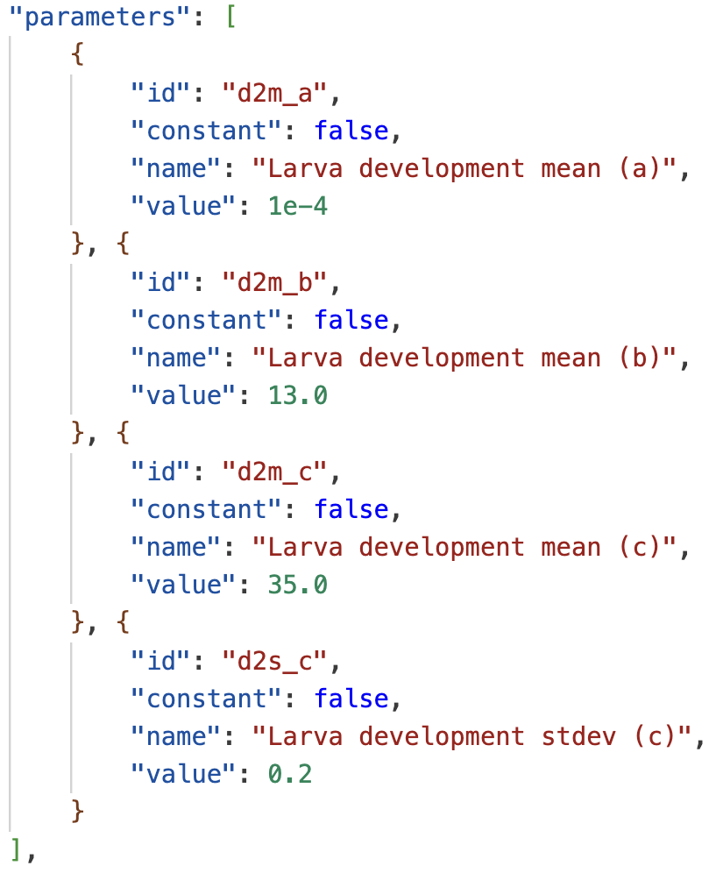
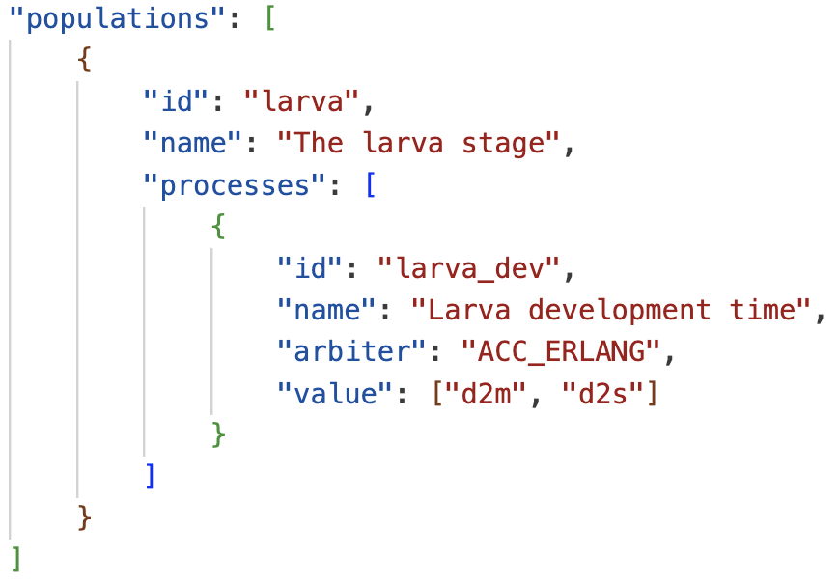
PopJSON

Slide 16
Give it a try

Slide 17
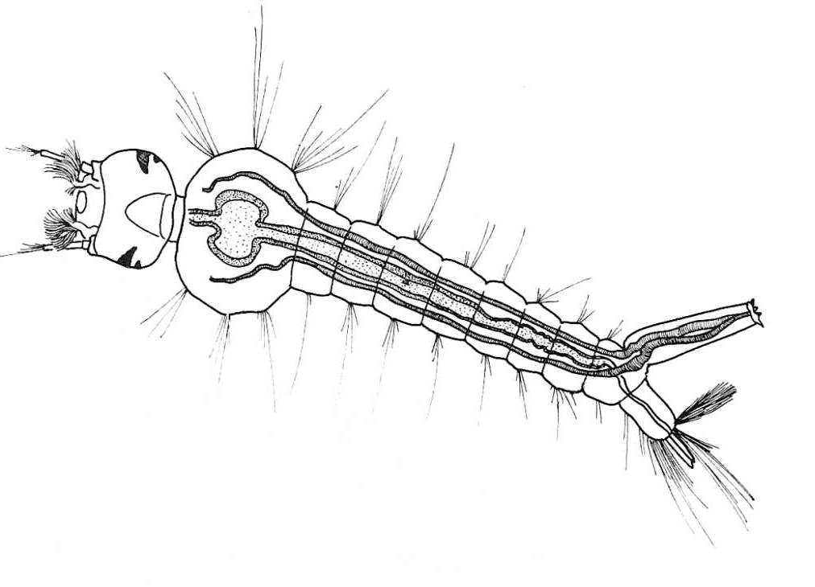
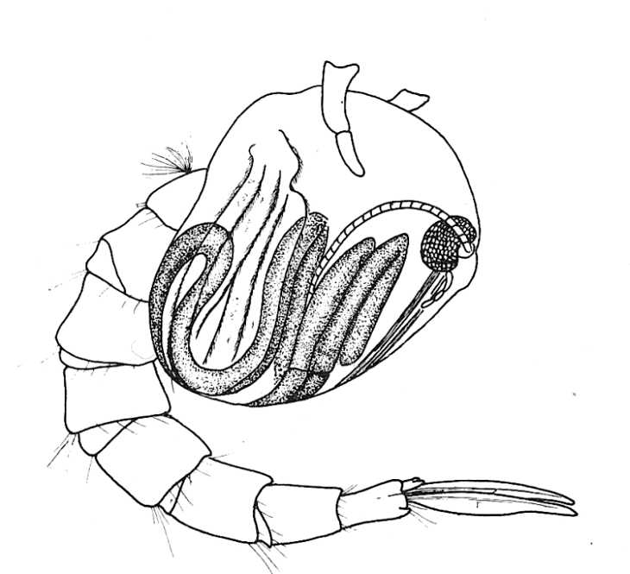
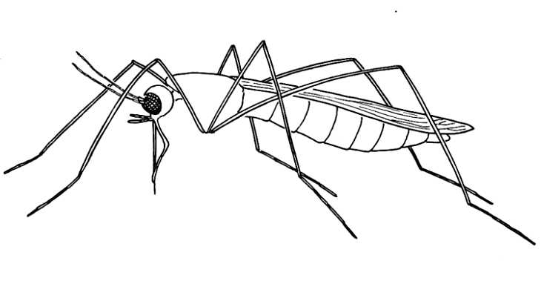
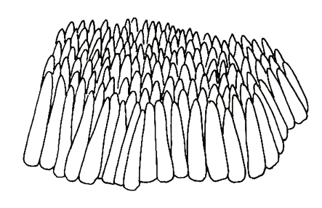
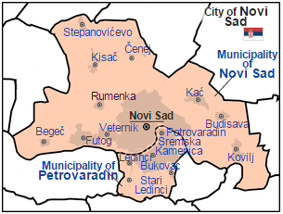
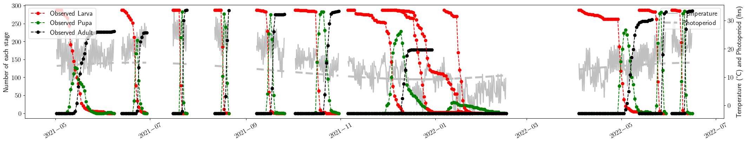
Development of Culex pipiens molestus in Serbia
Erguler K, et al. (2022) Sci. Rep.

Slide 18
Development of Culex pipiens molestus in Serbia
SPECIAL THANKS
Jacob Mendel Dušan Veljko Petrić Mina Petrić Mihaela Kavran Murat Can Demirok Filiz Günay Pantelis Georgiades Bülent Alten Jos Lelieveld
Erguler K, et al. (2022) Sci. Rep.

Slide 19
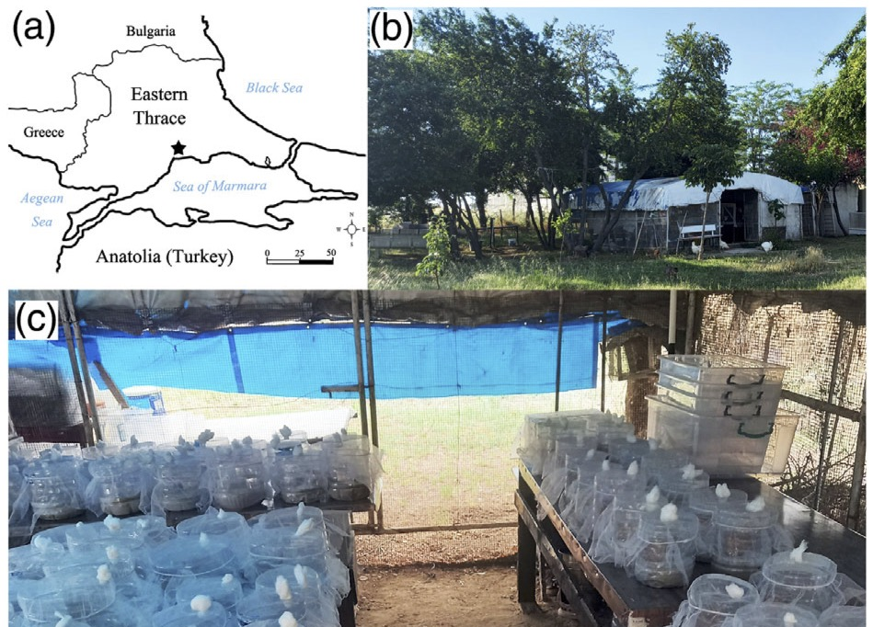
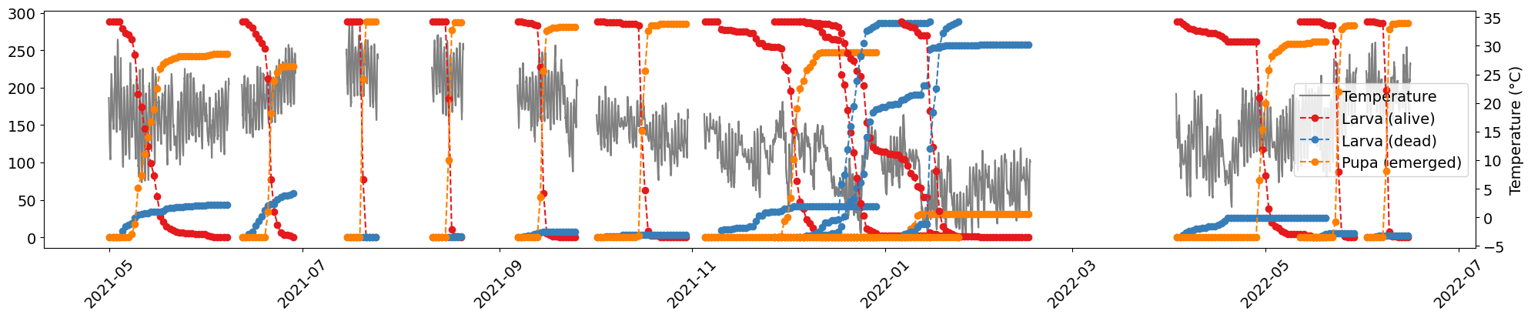
Development of Culex pipiens pipiens in Türkiye
Sakaci Z, et al. (2024) Med. & Vet. Ent.

Slide 20
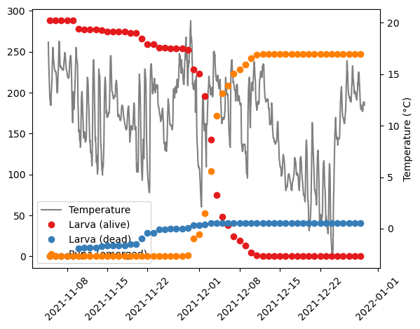
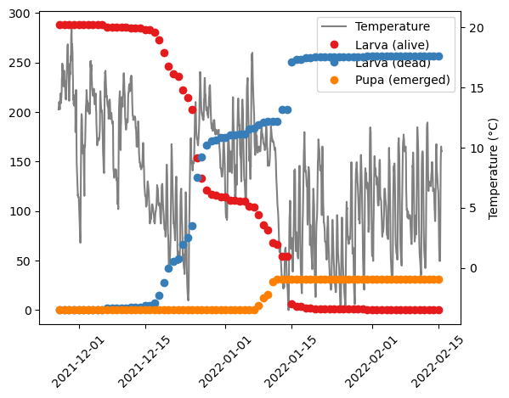
Development of Culex pipiens pipiens in Türkiye
November
SPECIAL THANKS
Zafer Şakaci Şengül Talay Adil Korkmaz Deniz Şirin Aylin Er Bülent Alten Sirri Kar
December
Sakaci Z, et al. (2024) Med. & Vet. Ent.

Slide 21
To be continued…

